Slide 1

Pradeep.V,
au962821205042,
Final Project
3/21/2024 Annual Review
1

Slide 2

PROJECT TITLE
IMAGE CLASSIFICATION
3/21/2024 Annual Review
2

Slide 3



AGENDA
1.Problem Statement
2.Proposed system/Solution
3.System Development Approach
4.Algorithm & Deployment
5.Result
6.References
3/21/2024 Annual Review
3

Slide 4

PROBLEM STATEMENT
Develop a Convolutional Neural Network (CNN) for precise image classification across diverse domains. Address challenges of data preprocessing, model architecture design, and optimization techniques like SGD and regularization. Utilize evaluation metrics such as accuracy and F1-score to gauge model performance. Aim to deploy an efficient CNN solution applicable in various sectors including healthcare, security, and autonomous systems.
3/21/2024 Annual Review
4

Slide 5

PROJECT OVERVIEW
Data Preparation: Gather and preprocess a diverse dataset suitable for training and evaluation.
CNN Architecture Design: Design an optimized CNN architecture tailored to the characteristics of the dataset and the complexity of the classification task.
Training and Optimization: Train the CNN model on the prepared dataset using optimization techniques.
Evaluation Metrics Selection: Define appropriate evaluation metrics such as accuracy, precision, recall, and F1-score to assess the performance of trained model on validation .
3/21/2024 Annual Review
5

Slide 6

WHO ARE THE END USERS?
1.Consumers of Image-Based Services/Apps.
2. Medical Professionals.
3. Manufacturing and Quality Control Personnel.
4. Autonomous Systems and Robotics.
3/21/2024 Annual Review
6

Slide 7

YOUR SOLUTION AND ITS VALUE PROPOSITION
1.Data Preparation.
2.CNN Architecture Design.
3.Training and Optimization.
4.Evaluation Metrics Selection.
5.Deployment and Integration.
6.Performance Monitoring and Updates.
3/21/2024 Annual Review
7

Slide 8

THE WOW IN YOUR SOLUTION
1.Prepare data: Collect and preprocess images.
2.Design model: Define CNN architecture.
3.Train model: Optimize weights using training data.
4.Evaluate: Assess model performance on test set.
5.Deploy: Export model, integrate into system, and classify incoming images.
1
3/21/2024 Annual Review
8

Slide 9
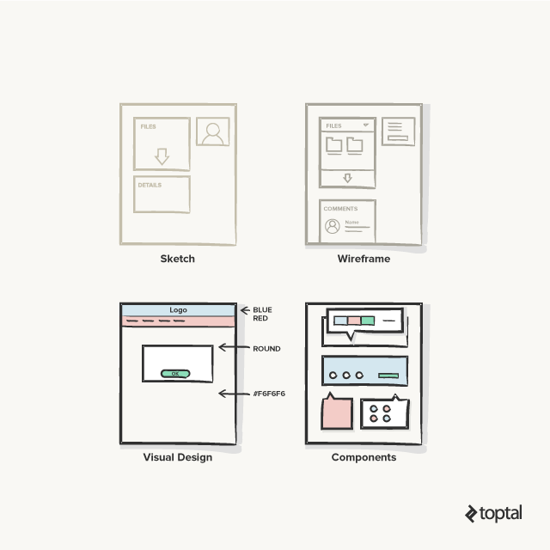
MODELLING
Wireframes:
3/21/2024 Annual Review
9

Slide 10
RESULTS
1.Accuracy indicates overall classification correctness.
2.Confusion matrix reveals distribution of correct and incorrect classifications.
3.Precision measures accuracy of positive predictions.
4.Recall assesses the ability to identify positives from all actual positives.
5.F1-score provides a balanced measure combining precision and recall.
Demo Link
3/21/2024 Annual Review
10

